Slide 1
Heating and Cooling Systems

Slide 2
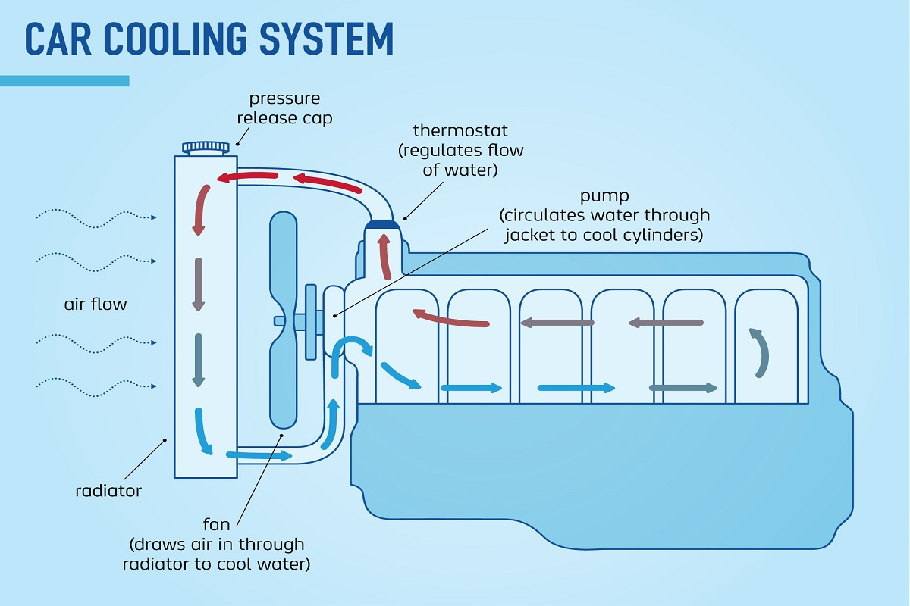
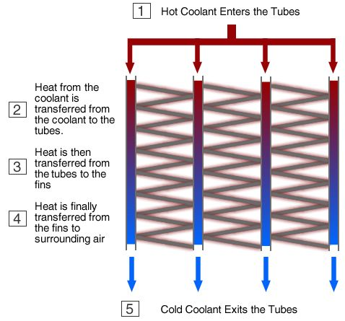
Engine Cooling in Cars
A petrol vehicle only converts 12-30% of the chemical energy stored in its fuel into kinetic energy in the wheels.
The rest is converted into other forms of energy – mostly heat. Excess heat must be removed to prevent damage to the engine.
A car’s cooling system consists of:
A pump: this pushes coolant around the engine.
A thermostat: this releases coolant into the radiator once it reaches a high temperature.
A radiator: this is a set of tubes surrounded by thin pieces of metal called radiator fins. Heat from the coolant is transferred to the fins, which then transfer it to the air moving past them.
A fan: this pulls air through the radiator as required to increase the rate of cooling.
Notes:
You should be able to find lots of examples of conduction here, and two examples of forced convection. Ironically, radiation is the least important form of heat transfer here.

Slide 3
Heat Pumps
Heat usually flows from hot objects to cold objects. Heat pumps allow the opposite: the movement of energy from a cold place to a warmer place.
A compressor pressurises a gas called refrigerant, driving up its temperature.
The refrigerant travels through a set of tubes called a condenser, where it releases heat to its surroundings and condenses into a liquid.
The refrigerant is depressurised by an expansion valve, which causes it to cool down.
The now-cool refrigerant travels through an evaporator, absorbing heat from its surroundings and turning into a gas as it does so. It then re-enters the compressor and the cycle repeats.
Gay-Lussac’s Law:
$$P∝T$$
(pressure is proportional to temperature: as the pressure of a gas increases, its temperature does too)
Notes:
Note that Gay-Lussac’s law assumes a constant volume and mass.
Why is latent heat important in this process?

Slide 4
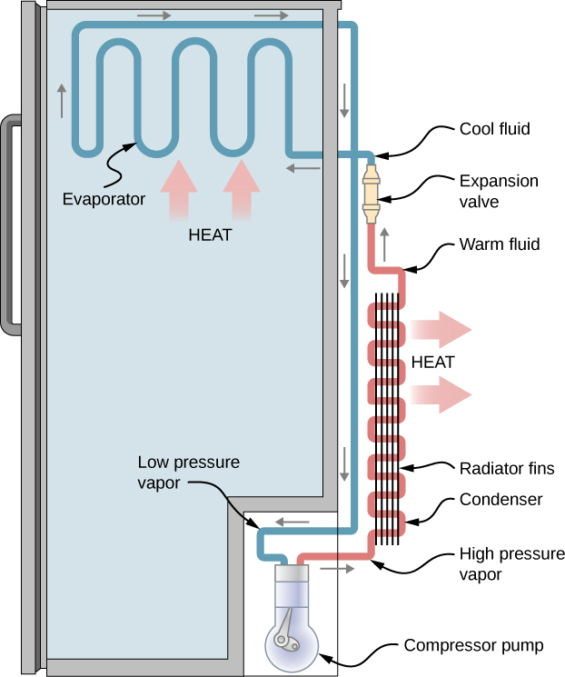
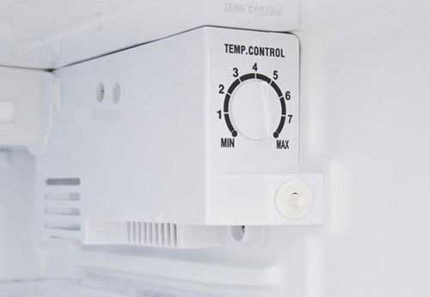
Refrigerator
Refrigerators use heat pumps:
the condenser is on the back, surrounded by radiator fins (similar to a car radiator)
the evaporator is inside the refrigerator, where it absorbs heat from the refrigerator’s contents
Refrigerators are usually equipped with adjustable thermostats, which turn off the compressor at a set temperature.

Slide 5
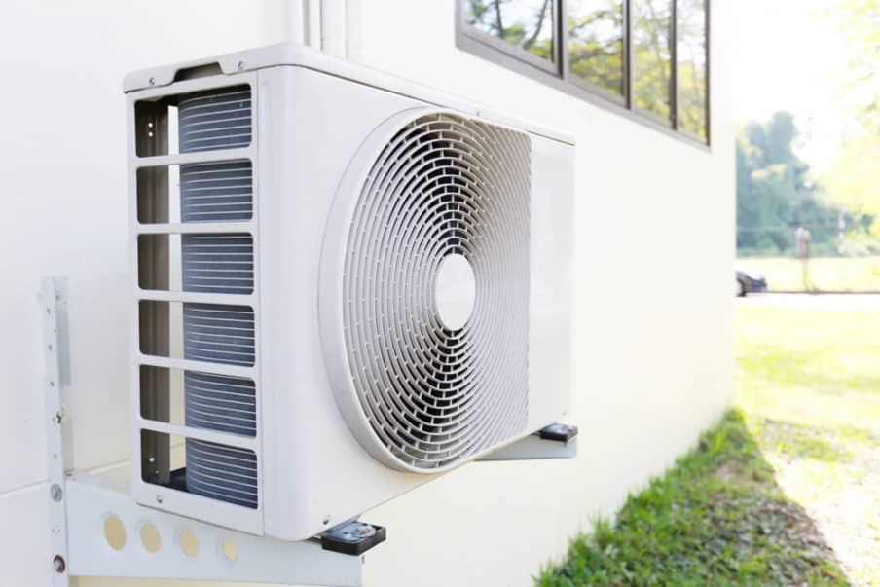
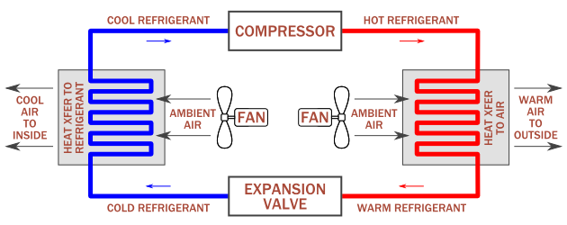
Air Conditioning
Refrigerative air conditioners also rely on heat pumps:
the condenser is outside, where fins and a fan assist with heat transfer to the air (similar to a car radiator)
the evaporator is inside, where it absorbs heat from the air
The cooled air is blown into the room by another fan.
(xfer = transfer)

Slide 6
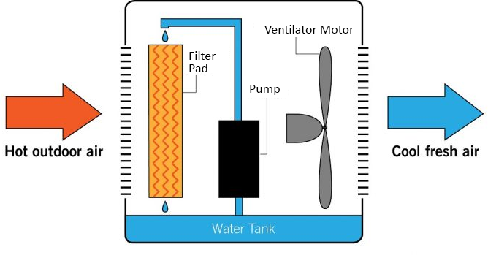
Evaporative Air Conditioning
Evaporative air conditioners cool a room by using the cooling effect of evaporating water.
air is forced through a wet filter pad
heat from the air is absorbed as the water in the pad evaporates
the cooled air is forced into the room by a fan
Notes:
Another example of latent heat being very useful!
Why doesn’t evaporative air conditioning work as well on humid days?

Slide 7
Passive Solar House Design
There are a number of ways that the design of a house can help with heat transfer:
Positioning of the building: the longest side of the building should be facing north (in the southern hemisphere)
Have plenty of windows on this side to allow winter sun in
Have large eaves (the parts of the roof that overhang the building) to block the summer sun

Slide 8
Passive Solar House Design
There are a number of ways that the design of a house can help with heat transfer:
Positioning of rooms: place rooms that are used during the day (e.g. living room, dining room) in the north end of the house to make the most of the winter sun
Bedrooms can be placed in the southern end where they will stay cool during summer

Slide 9
Passive Solar House Design
There are a number of ways that the design of a house can help with heat transfer:
Insulation: houses (and other buildings) can be insulated in a number of ways
Double glazed windows are made of two glass panels with a pocket of air in between – since air is a poor conductor of heat, this slows down the flow of heat into the house
Double brick walls work on the same principle
Fibreglass insulation in the walls and ceiling has a similar effect
Notes:
Note that double glazing does nothing to protect you from heating by radiation

Slide 10
Passive Solar House Design
There are a number of ways that the design of a house can help with heat transfer:
Shade: trees and other sources of shade can prevent sunlight entering a house
Deciduous trees are especially useful since they lose their leaves in the colder months.

Slide 11
Passive Solar House Design
There are a number of ways that the design of a house can help with heat transfer:
Thermal mass: describes a material’s ability to absorb, store and release heat
Materials with high thermal mass (e.g. brick, stone, concrete) are helpful in summer, since they absorb lots of heat before releasing it slowly into the house
In winter, these materials absorb heat during the day and release it at night, keeping the house warm

